Slide 1
Advanced Web programming
Lec-9
Introduction to Visual Studio

Slide 2
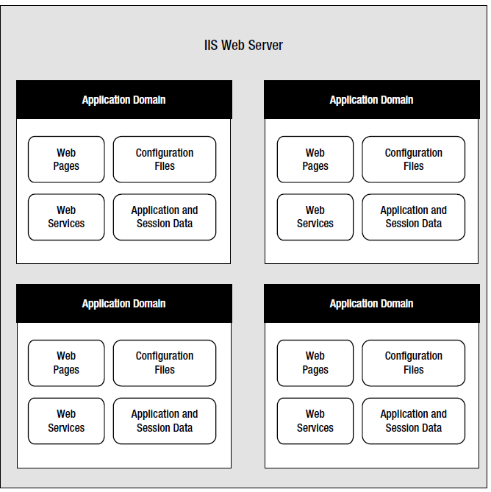
Anatomy of an ASP.NET Application
The standard definition of an ASP.NET application describes it as a combination of files, pages, handlers, modules, and executable code that can be invoked from a virtual directory (and, optionally, its subdirectories) on a web server.
Figure 5-1 shows a web server that hosts four separate web applications.

Slide 3
ASP.NET File Types
Ends with .aspx -These are ASP.NET web pages. They contain the user interface and, optionally, the underlying application code. Users request or navigate directly to one of these pages to start your web application.
Ends with .ascx- These are ASP.NET user controls. User controls are similar to web pages, except that the user can’t access these files directly. Instead, they must be hosted inside an ASP.NET web page. User controls allow you to develop a small piece of user interface and reuse it in as many web forms as you want without repetitive code.
web.config- This is the configuration file for your ASP.NET application. It includes settings for customizing security, state management, memory management, and much more.
global.asax- This is the global application file. You can use this file to define global variables (variables that can be accessed from any web page in the web application) and react to global events (such as when a web application first starts).
Ends with .cs- These are code-behind files that contain C# code. They allow you to separate the application logic from the user interface of a web page.

Slide 4
HTML Server Controls
HTML server controls provide an object interface for standard HTML elements. They provide three key features:
1. They generate their own interface: You set properties in code, and the underlying HTML tag is created automatically when the page is rendered and sent to the client.
2. They retain their state: Because the Web is stateless, ordinary web pages need to do a lot of work to store information between requests. HTML server controls handle this task automatically. For example, if the user selects an item in a list box, that item remains selected the next time the page is generated. Or if your code changes the text in a button, the new text sticks the next time the page is posted back to the web server.
3. They fire server-side events: For example, buttons fire an event when clicked, text boxes fire an event when the text they contain is modified, and so on. Your code can respond to these events, just like ordinary controls in a Windows application. If a given event doesn’t occur, the event handler won’t be executed.

Slide 5
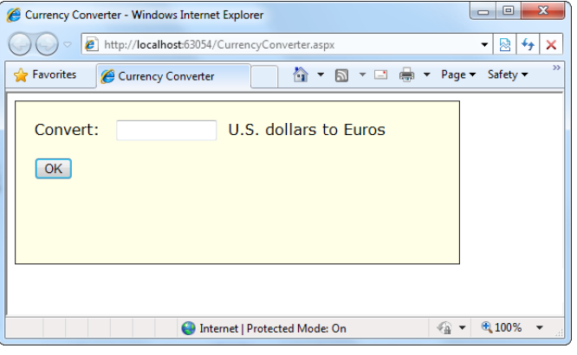
Converting an HTML Page to an ASP.NET Page
Figure 5-2 shows a currency converter web page. When designed, it’s just a plain, inert HTML page. Nothing happens when the button is clicked.

Slide 6
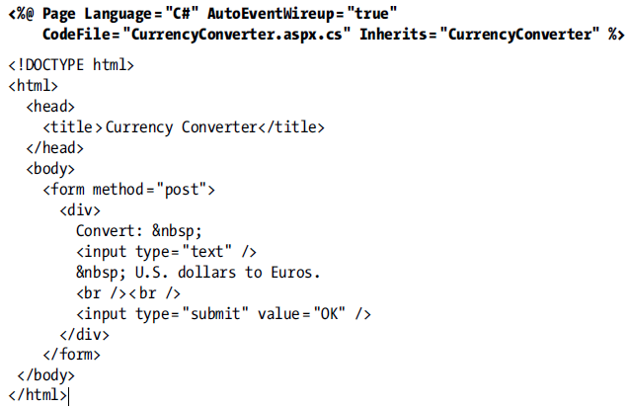
In the currency converter application, it makes sense to change the input text box and the submit button into HTML server controls.
In addition, the <form> element must be processed as a server control to allow ASP.NET to access the controls it contains. The &nbsp (non-breaking space); character entity is used to add an extra space to separate the controls.

Slide 7
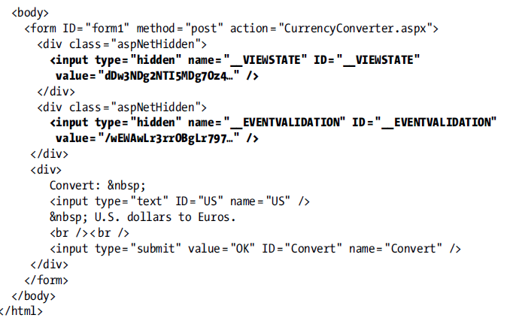
Now you need to add the attribute runat = "server" to each tag that you want to transform into a server
control.
You should also add an ID attribute to each control that you need to interact with in code.
The ID attribute assigns the unique name that you’ll use to refer to the control in code.
View State

Slide 8
ASP.NET has added two new hidden <input> elements, each of which is nested in a separate <div> element container. The second hidden field is used to stop certain types of web page tampering. It works behind the scenes.
More interesting is the first hidden field, which stores information, in a compressed format, about the state of every control in the page:
<input type = "hidden" name = "__VIEWSTATE" ID = "__VIEWSTATE"
value = "dDw3NDg2NTI5MDg7Oz4. . ." />
This information is called the view state of the page. Because the view state information is stored in your page, your code can change control properties at any time, and these changes will automatically “stick.”
For example, if you change the background color of a box, that box will keep its new color, no matter how many times the page is sent back and forth between the browser and the web server.

Slide 9
A web application is stateless. That means that a new instance of a page is created every time when we make a request to the server to get the page and after the round trip our page has been lost immediately.
It only happens because of one server, all the controls of the Web Page is created and after the round trip the server destroys all the instances. So to retain the values of the controls we use state management techniques.
View State
View State is the method to preserve the Value of the Page and Controls between round trips. It is a Page-Level State Management technique. View State is turned on by default and normally serializes the data in every control on the page regardless of whether it is actually used during a post-back.
Features Of View State
These are the main features of view state,
Retains the value of the Control after post-back without using a session where PostBack is the name given to the process of submitting an ASP.NET page to the server for processing.
Stores the value of Pages and Control Properties defined in the page.
Creates a custom View State Provider that lets you store View State Information in a SQL Server Database or in another data store.

Slide 10
{for your information}
IIS: Internet Information Services (IIS) is a flexible, general-purpose web server from Microsoft that runs on Windows systems to serve requested HTML pages or files. An IIS web server accepts requests from remote client computers and returns the appropriate response.
Most commonly, IIS is used to host ASP.NET web applications and static websites. It can also be used as an FTP server, host WCF services, and be extended to host web applications built on other platforms such as PHP. There are built-in authentication options such as Basic, ASP.NET, and Windows auth.
There’s one ASP.NET object that doesn’t use this attribute system, because it doesn’t have a control tag— the web page. Instead, ASP.NET connects the web page events based on method names. In other words, if you have a method named Page_Load() in your page class, and it has the right signature (it accepts two parameters, an object representing the sender and an EventArgs object), ASP.NET connects this event handler to the Page.Load event automatically. This feature is called automatic event wireup.

Slide 11
Behind the Scenes
1. The request for the page is sent to the web server. If you’re running a live site, the web server is almost certainly IIS. If you’re running the page in Visual Studio, the request is sent to the built-in test server.
2. The web server determines that the .aspx file extension is registered with ASP.NET. If the file extension belonged to another service (as it would for .html files, for example), ASP.NET would never get involved.
3. If this is the first time a page in this application has been requested, ASP.NET automatically creates the application domain. It also compiles all the web page code for optimum performance, and caches the compiled files. If this task has already been performed, ASP.NET will reuse the compiled version of the page.
4. The compiled PROGRAM_NAME.aspx page acts like a miniature program. It starts firing events (most notably, the Page.Load event). However, you haven’t created an event handler for that event, so no code runs. At this stage, everything is working together as a set of in-memory .NET objects.
5. When the code is finished, ASP.NET asks every control in the web page to render itself into the corresponding HTML markup.
6. The final page is sent to the user, and the application ends.

Slide 12
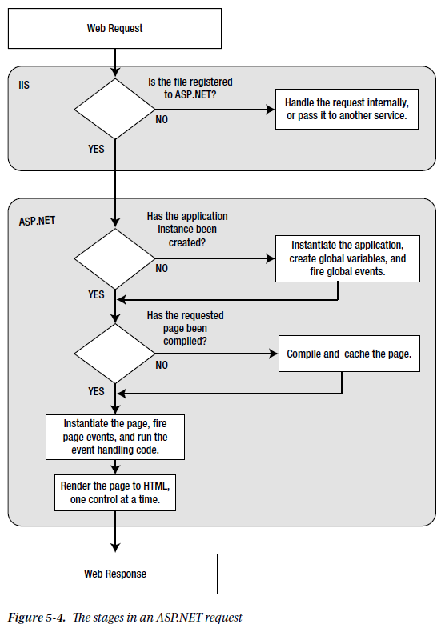

Slide 13
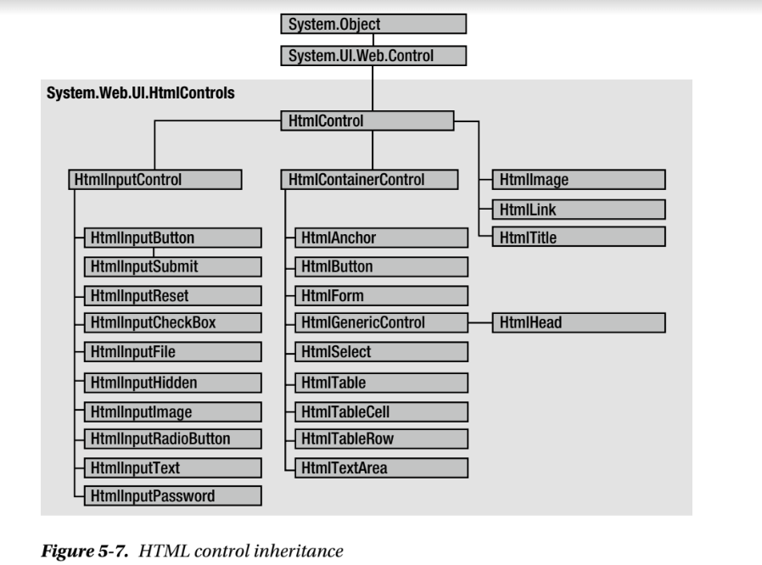
HTML
control classes
refer book pg. no. 129

Slide 14
To be continued….

Slide 15
Lec 10 quiz
https://forms.gle/gfpJwXNyzZjMbvPZ6

